Slide 1

SOCIAL DISTANCING ALERT DEVICE
Team Members
K.V.R Pranav (19B81A04H0)
V Sai Rahul (19B81A04F3)
M Satvika (19B81A04F5)
Supervisor
name of the faculty member :Mr. D Bhanu Prakash
Designation:Associate Professor

Slide 2
OUTLINE OF THE PRESENTATION
Motivation
Objective
System Model (Block Diagram, Snapshot of Hardware & / Software, Description(Hardware, Software ), Algorithm & Flowchart )

Slide 3
MOTIVATION
Social Distancing Alerting Device (SDAD) is a hardware-based project.
In the present times ,as Covid -19 pandemic has been rampant , we need to be cautious in the social and public gatherings.
It is a miniaturized version to ensure that social distancing is maintained .
It is a simple gadget which can be up-scaled later for larger uses in offices, worksites and public places wherever queuing system is found.

Slide 4
OBJECTIVE
Using simple technology to develop a low-cost Social Distancing Alert Device (SDAD) in order to prevent violation of covid norms at public queues.

Slide 5
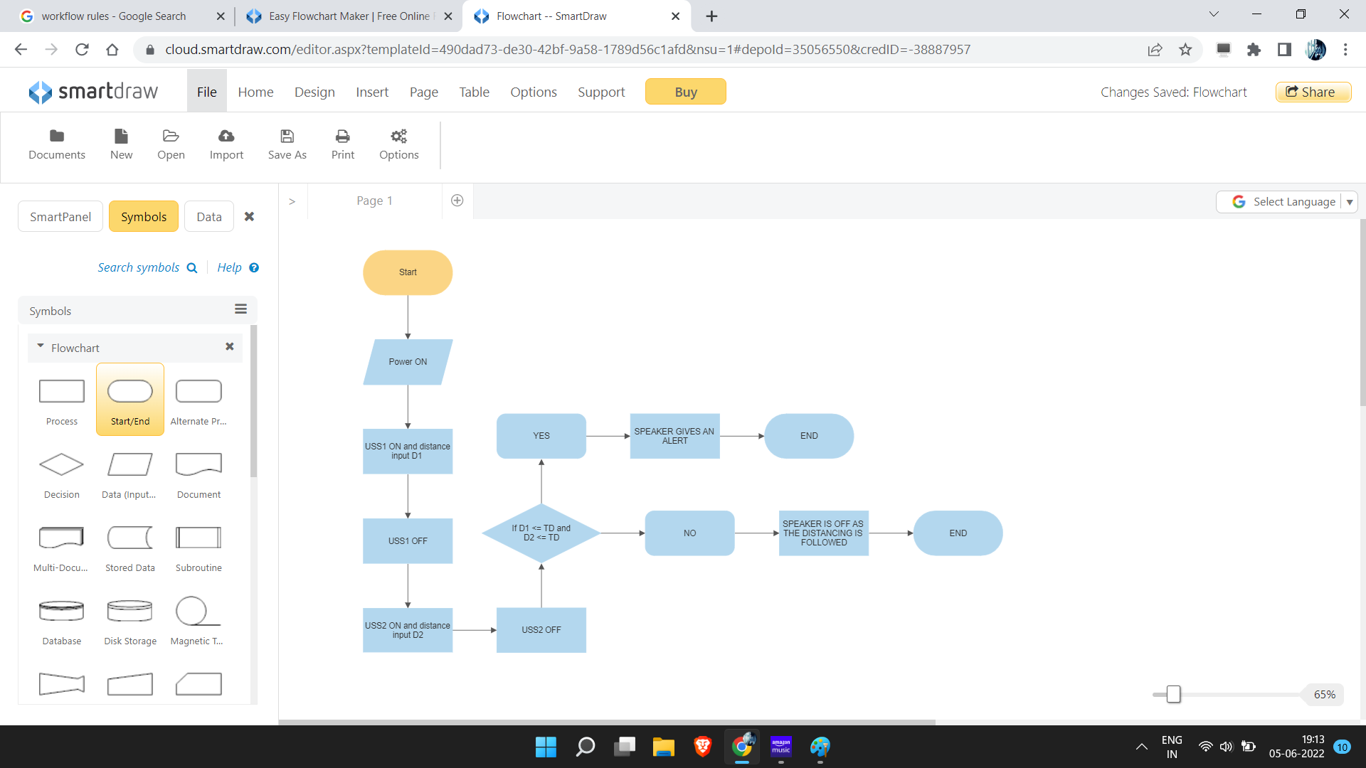
Methodology
USS : Ultra Sonic Sensor
TD : Threshold Distance
D1: Distance 1
D2 : Distance 2

Slide 6
Working of the project
In the beginning , both the sensors detect the distances D1 and D2 between the reference person and the ones behind him/her and to their right .
Once the distances are detected , they are then compared to the threshold distance 6 feet (180 cm).
When the threshold is not satisfied ,automatically the speaker gives an alert to maintain social distancing.

Slide 7
Microcontroller and other components specifications
Arduino UNO microcontroller board is used which is based on the ATmega328P. It has 14 digital input/output pins (of which 6 can be used as PWM outputs), 6 analog inputs, a 16 MHz ceramic resonator, a USB connection, a power jack, an ICSP header and a reset button.
HC-SRO4 Ultra Sonic Sensor (USS).It can report the range of objects up to 13 feet away.
Speaker
Breadboard
Jumper Cables
The software used is Arduino IDE.

Slide 8
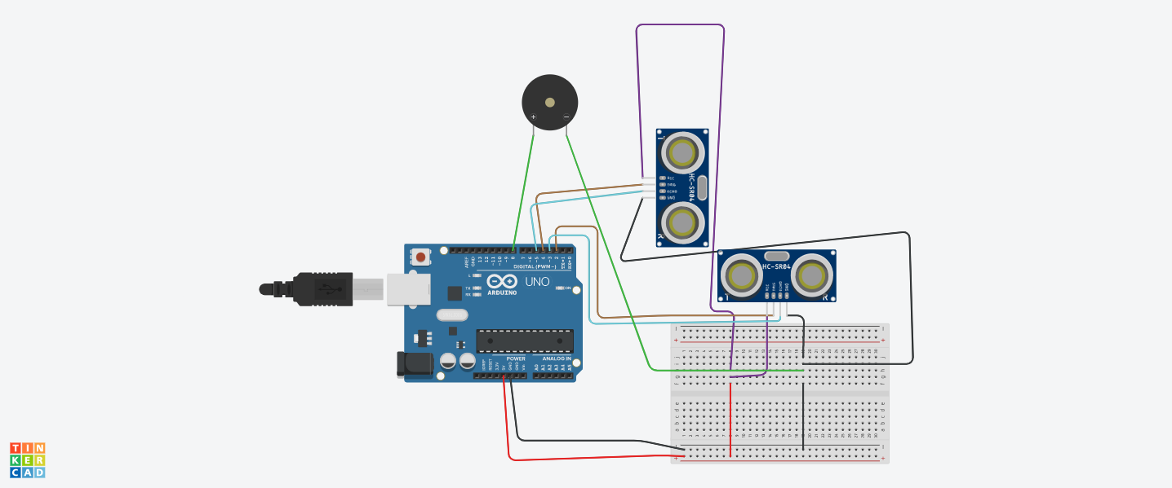
Circuit Diagram

Slide 9
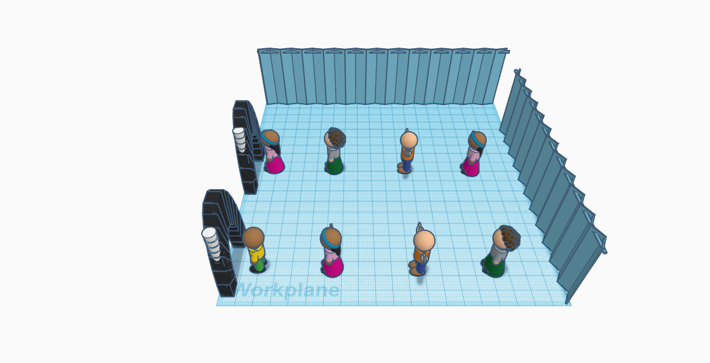
3D Model of the Project

Slide 10
Description of the 3D Model
This model depicts a typical “Queue” system.
The arches are the counters issuing tickets/ tokens, billing centres, security checking areas etc.
The white colour sticks placed at the side or on top of the arch are the SDA (Social distancing alert) devices aligned to the queue line.
This is the pictorial depiction of how our project works

Slide 11
Conclusions
This SDAD has wider applications which includes correcting violation of covid norms such as social distancing . Also , to prevent stampedes during purchase of tickets at movie theatres , airports , railway stations , bus stands , fair price shops (Ration shops), banks and even for entry level into examination centers. It can also perhaps be fine tuned or modified to be used on the rear side of the vehicles to give an alert for a collision, and emergency brakes automatically to avoid maximum damage to vehicles when they move too close to an obstacle . Further to detect accident wreckages and protection of VIPs and so on.

Slide 12
THANK YOU

